Slide 1

Jonathon Marshall
Competency Portfolio
www.infratec-uk.com

Slide 2
Competency Summary
Category | Accreditation Body | No. | Expiry
Highways Passport | Mitie | 14-00064806 | 11/06/2025
Lorry Loader D1+D5+E | ALLMI | 244804 | 30/05/2027
Level 2 Principles of Manual Handling | Qualsafe Awards | 3389505 | 13/06/2027
Level 3 Emergency First Aid at Work | Qualsafe Awards | 3400362 | 20/06/2027
Highways Electrical Registration Scheme (HERS) | HEA | H1243615 | 04/02/2028
www.infratec-uk.com

Slide 3
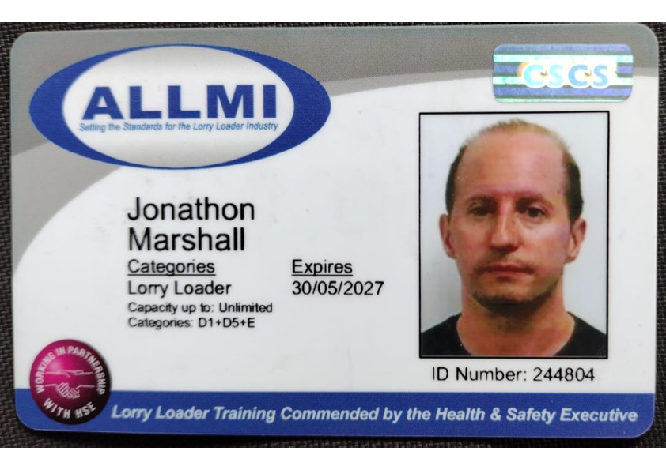
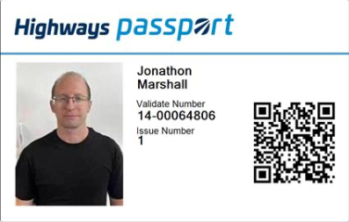
Competency Cards
ALLMI
HCI
HERS
www.infratec-uk.com

